Slide 1
FragmentAllFiles.kt
All’interno di questo fragment vengono mostrate le directories e i files creati/salvati dall’utente
Esistono due diverse modalità di visualizzazione

Slide 2
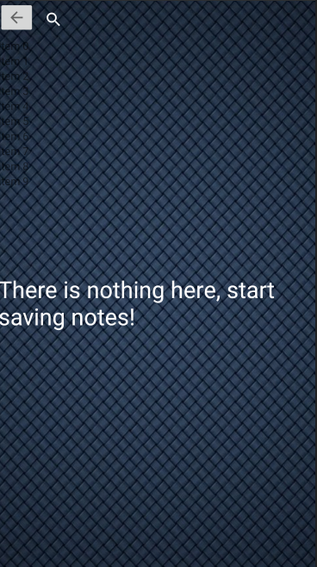
Fragment_all_files.xml
La recycler view mostra le directories oppure i files all’interno della directory selezionata dall’utente.
L’ ImageButton viene mostrato all’utente solamente se si stanno mostrando i files nella directory, altrimenti è invisibile.
La textView è visibile solamente se non sono presenti directories oppure non sono presenti files all’interno della directory selezionata.

Slide 3
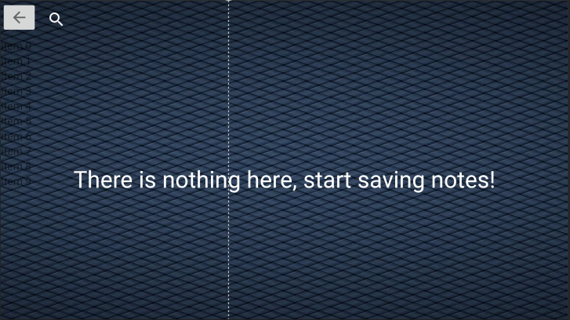
Fragment_all_files.xml (land)

Slide 4

Menu_all_files.xml
Il menu è strutturato in tre item

Slide 5
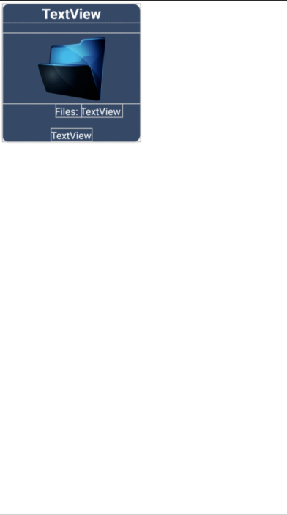
Item_directory_big.xml
Il layout rappresenta il folder mostrato all’utente se viene scelta la modalità di visualizzazione DIR_BIG

Slide 6

Item_directory_small.xml
Il layout rappresenta il folder mostrato all’utente se viene scelta la modalità di visualizzazione DIR_SMALL

Slide 7

Item_file_big.xml
Il layout rappresenta come vengono mostrati i files all’interno della directory se viene scelta la modalità di visualizzazione BIG

Slide 8

Item_file_small.xml
Il layout rappresenta come vengono mostrati i files all’interno della directory se viene scelta la modalità di visualizzazione SMALL

Slide 9
Settaggio degli Observer
private fun setLiveData(){ val directoryObserver = Observer<List<Directory>>(){ setUI() setAdapterDirectory(it) } val listObserver = Observer<List<Note>>(){ setUI() setAdapterFiles(it) } viewModel.listDirectory.observe(requireActivity(),directoryObserver) viewModel.listNotes.observe(requireActivity(),listObserver) }

Slide 10
Adapters
Sono stati implementati quattro diversi adapter: due adapter per quanto riguarda i files e due adapter per le directories
Il motivo di ciò è perché esistono quattro modalità di visualizzazione, due per i files e due per le directories

Slide 11
setAdapterDirectory ()
private fun setAdapterDirectory(listDirectory: List<Directory>){ binding.rvFiles.invalidate() Log.d("DIR_SIZE",listDirectory.size.toString()) if(showMode == FilesShowMode.DIR_BIG){ adapterDirectoryBig = DirectoryBigAdapter(listDirectory, requireContext(),this,spanCount) binding.rvFiles.adapter = adapterDirectoryBig } else if (showMode == FilesShowMode.DIR_SMALL){ adapterDirectorySmall = DirectorySmallAdapter(listDirectory,requireContext(),this) binding.rvFiles.adapter = adapterDirectorySmall } }

Slide 12
setAdapterFiles ()
private fun setAdapterFiles(listFiles: List<Note>){ if(showMode == FilesShowMode.BIG){ adapter = AllFilesBigAdapter(listFiles,requireContext(),this) binding.rvFiles.adapter=adapter } else{ adapterSmall = AllFilesSmallAdapter(listFiles,requireContext(),this,this) binding.rvFiles.adapter=adapterSmall } }

Slide 13
setUI()
val note = Note() note.id = -1 viewModel.selectedNote.value = note binding.rvFiles.invalidate() binding.rvFiles.invalidateItemDecorations() binding.rvFiles.adapter = null binding.rvFiles.layoutManager = null val layoutManager: RecyclerView.LayoutManager for(i in 0 until binding.rvFiles.itemDecorationCount){ binding.rvFiles.removeItemDecorationAt(i) }

Slide 14
setUI() (2)
val orientation = requireContext().resources.configuration.orientation if(orientation == Configuration.ORIENTATION_LANDSCAPE && showMode == FilesShowMode.SMALL){ binding.previewLayout!!.isVisible = true binding.guidelineAllFiles!!.setGuidelinePercent(0.4f) childFragmentManager.beginTransaction() .replace(binding.previewLayout!!.id, FragmentNoteDetails(), DETAILS_FRAGMENT_TAG ) .commit() } else{ if(orientation == Configuration.ORIENTATION_LANDSCAPE){ binding.previewLayout!!.isVisible = false binding.guidelineAllFiles!!.setGuidelinePercent(1f) } }

Slide 15
setUI() (3)
when(showMode) { FilesShowMode.BIG -> { spanCount = if(orientation == Configuration.ORIENTATION_LANDSCAPE) 4 else 2 layoutManager = StaggeredGridLayoutManager(spanCount, StaggeredGridLayoutManager.VERTICAL) (layoutManager as StaggeredGridLayoutManager).gapStrategy=StaggeredGridLayoutManager.GAP_HANDLING_NONE } FilesShowMode.DIR_BIG -> { spanCount = if(orientation == Configuration.ORIENTATION_LANDSCAPE) 5 else 3 layoutManager = StaggeredGridLayoutManager(spanCount, StaggeredGridLayoutManager.VERTICAL) (layoutManager as StaggeredGridLayoutManager).gapStrategy=StaggeredGridLayoutManager.GAP_HANDLING_NONE } FilesShowMode.DIR_SMALL -> { spanCount = 1 layoutManager = LinearLayoutManager(requireContext()) } FilesShowMode.SMALL -> { spanCount = 1 layoutManager = LinearLayoutManager(requireContext()) } }

Slide 16
setUI() (4)
binding.rvFiles.layoutManager = layoutManager if(showMode==FilesShowMode.DIR_BIG || showMode == FilesShowMode.BIG) { if (binding.rvFiles.itemDecorationCount == 0) { binding.rvFiles.addItemDecoration( GridSpacingDecorator( resources.getDimensionPixelSize(R.dimen.cardView_margin), spanCount ) ) } } else{ if(binding.rvFiles.itemDecorationCount == 0){ binding.rvFiles.addItemDecoration( LinearSpacingDecorator(resources.getDimensionPixelSize(R.dimen.cardView_margin), spanCount)) } }

Slide 17
setUI() (5)
if(showMode == FilesShowMode.DIR_BIG || showMode == FilesShowMode.DIR_SMALL){ binding.imageButton.visibility=View.GONE } else{ if(viewModel.listNotes.value != null) setAdapterFiles(viewModel.listNotes.value!!) binding.imageButton.visibility=View.VISIBLE } binding.imageButton.setOnClickListener{ showMode = if(showMode == FilesShowMode.BIG) FilesShowMode.DIR_BIG else FilesShowMode.DIR_SMALL mActionMode = null selectedItem = ArrayList() setUI() loadData() } binding.sv.setOnQueryTextListener(MyQueryListener()) }

Slide 18
loadData()
private fun loadData(){ Log.d("RESUME","RESUME") val dao = DbDigitalPhotoEditor.getInstance(requireContext()).digitalPhotoEditorDAO() CoroutineScope(Dispatchers.IO).launch{ val results = dao.loadDirectories() val listDirectory = mutableListOf<Directory>() var size = 0 var lastModify: Long for(res in results){ size = dao.loadDirectorySize(res) lastModify = dao.getLastModifyDir(res) listDirectory.add(Directory(res,size, Date(lastModify))) } CoroutineScope(Dispatchers.Main).launch { viewModel.listDirectory.value = listDirectory binding.textView7.isVisible = listDirectory.isEmpty() } } }

Slide 19
Metodi chiamati negli adapter
All’interno delle classi adapter vengono chiamati i seguenti metodi della classe FragmentAllFiles:

Slide 20
selectedHandler
override fun selectedHandler(element: Any): Boolean { var isFirst = false if(selectedItem.isEmpty()){ mActionMode = requireActivity().startActionMode(AllFilesActionModeCallback()) isFirst = true } if(selectedItem.contains(element)) { selectedItem.remove(element) if(selectedItem.size==0) mActionMode!!.finish() return false } selectedItem.add(element) if(isFirst) { val note = Note() note.id = -1 viewModel.selectedNote.value = note //Invoke reset only if the fragment exists (if (childFragmentManager.findFragmentByTag(DETAILS_FRAGMENT_TAG) == null) null else (childFragmentManager.findFragmentByTag(DETAILS_FRAGMENT_TAG) as FragmentNoteDetails))?.reset() } return true }

Slide 21
fun isSelected(note: Note): Boolean{ for(any in selectedItem){ if(any is Note){ if(any.id == note.id) return true } } return false } override fun isAnItemSelected(): Boolean { return selectedItem.isNotEmpty() }

Slide 22
changeToFiles
fun changeToFiles(directory: String){ CoroutineScope(Dispatchers.IO).launch{ val files = DbDigitalPhotoEditor.getInstance(requireContext()).digitalPhotoEditorDAO().loadAllByDirectory(directory) CoroutineScope(Dispatchers.Main).launch{ if(showMode == FilesShowMode.DIR_BIG) showMode = FilesShowMode.BIG else if(showMode == FilesShowMode.DIR_SMALL) showMode = FilesShowMode.SMALL setUI() actualDirectory = directory viewModel.listNotes.value=files.toMutableList() viewModel.sort(sortingType) selectedItem = ArrayList() mActionMode = null } } }

Slide 23
Menu Contestuale
Tenendo premuto su una directory o sul un file è possibile abilitare la selezione multipla degli elementi per poi dare all’utente la possibilità di eseguire determinate azioni

Slide 24
private inner class AllFilesActionModeCallback() : ActionMode.Callback{ override fun onCreateActionMode(mode: ActionMode?, menu: Menu?): Boolean { if(showMode==FilesShowMode.DIR_BIG || showMode == FilesShowMode.DIR_SMALL) mode!!.menuInflater.inflate(R.menu.menu_onlong_digital,menu) else mode!!.menuInflater.inflate(R.menu.menu_onlong_files,menu) return true } override fun onPrepareActionMode(mode: ActionMode?, menu: Menu?): Boolean { return false } override fun onActionItemClicked(mode: ActionMode?, item: MenuItem?): Boolean { if(showMode==FilesShowMode.BIG || showMode == FilesShowMode.SMALL){ //Files case when(item!!.itemId){ R.id.it_files_delete -> deleteFiles(mode) R.id.it_files_merge -> mergeFiles(mode) else -> deleteFiles(mode) } } else{ //Directory case deleteDirectories(mode) } return true } override fun onDestroyActionMode(mode: ActionMode?) { selectedItem = ArrayList() mActionMode=null }

Slide 25
private fun deleteDirectories(mode: ActionMode?){ val alertDialog = AlertDialog.Builder(requireContext()) alertDialog.setTitle(R.string.delete_directories_alert_title) alertDialog.setMessage(R.string.delete_directories_alert_message) alertDialog.setPositiveButton(R.string.yes){ dialogInterface: DialogInterface, i: Int -> CoroutineScope(Dispatchers.IO).launch{ val dao = DbDigitalPhotoEditor.getInstance(requireContext()).digitalPhotoEditorDAO() val listDir = ArrayList<Directory>() for(elem in selectedItem){ if(elem is Directory){ dao.deleteDirectory(elem.name) listDir.add(elem) } } CoroutineScope(Dispatchers.Main).launch{ val newList = viewModel.listDirectory.value!! newList.removeAll(listDir) viewModel.listDirectory.value = newList dialogInterface.dismiss() mode!!.finish() } } } alertDialog.setNegativeButton(R.string.no){ dialogInterface: DialogInterface, _: Int -> dialogInterface.dismiss() mode!!.finish() } alertDialog.show() }

Slide 26
private fun deleteFiles(mode: ActionMode?){ val alertDialog = AlertDialog.Builder(requireContext()) alertDialog.setTitle(R.string.delete_files_alert_title) alertDialog.setTitle(R.string.delete_files_alert_message) alertDialog.setPositiveButton(R.string.yes){ dialogInterface: DialogInterface, _: Int -> val dao = DbDigitalPhotoEditor.getInstance(requireContext()).digitalPhotoEditorDAO() CoroutineScope(Dispatchers.IO).launch{ val listNote = ArrayList<Note>() for(elem in selectedItem){ if(elem is Note) listNote.add(elem) } dao.deleteAll(listNote) CoroutineScope(Dispatchers.Main).launch{ val list = viewModel.listNotes.value!! list.removeAll(listNote) viewModel.listNotes.value = list dialogInterface.dismiss() mode!!.finish() } } } alertDialog.setNegativeButton(R.string.no){ dialogInterface: DialogInterface, _: Int -> dialogInterface.dismiss() mode!!.finish() } alertDialog.show() }

Slide 27
private fun mergeFiles(mode: ActionMode?){ val stringBuilder = StringBuilder() for(elem in selectedItem){ if(elem is Note){ stringBuilder.append(elem.text) stringBuilder.append("\n") } } val note = Note(stringBuilder.toString(),"","","und",System.currentTimeMillis(),false) val intent = Intent(requireContext(),TextResultActivity::class.java) intent.putExtra("result",note) intent.putExtra("type", TextResultType.NOT_SAVED.ordinal) requireContext().startActivity(intent) mode!!.finish() }

Slide 28
Cambiare la modalità visualizzazione dei dati (1)
R.id.it_preview -> { selectedItem = ArrayList() mActionMode = null if (showMode == FilesShowMode.DIR_BIG || showMode == FilesShowMode.BIG) { Log.d("HERE", "HERE") item.icon = ContextCompat.getDrawable( requireContext(), R.drawable.ic_baseline_grid_view_24 ) if (showMode == FilesShowMode.DIR_BIG) { showMode = FilesShowMode.DIR_SMALL setUI() setAdapterDirectory(viewModel.listDirectory.value!!) } else { showMode = FilesShowMode.SMALL setUI() setAdapterFiles(viewModel.listNotes.value!!) } }

Slide 29
Cambiare la modalità visualizzazione dei dati (2)
} else { item.icon = ContextCompat.getDrawable( requireContext(), R.drawable.ic_baseline_format_list_bulleted_24 ) if (showMode == FilesShowMode.DIR_SMALL) { showMode = FilesShowMode.DIR_BIG setUI() setAdapterDirectory(viewModel.listDirectory.value!!) } else { showMode = FilesShowMode.BIG setUI() setAdapterFiles(viewModel.listNotes.value!!) } } }

Slide 30
R.id.it_filter -> { val sharedPreferences = requireActivity().getSharedPreferences("filter_all_files", Activity.MODE_PRIVATE) var filterMode = sharedPreferences.getInt("filterMode",FilterMode.BY_TEXT.ordinal) var sortingType = sharedPreferences.getInt("sortingType",SortingType.ALPHABETIC_ASC.ordinal) val dialog = FilterDialog.getInstance(filterMode,sortingType) dialog.setOnFilterSelected{ filter: FilterMode, sorting: SortingType -> selectedItem = ArrayList() mActionMode = null filterMode = filter.ordinal sortingType = sorting.ordinal this.filterMode = filter this.sortingType = sorting

Slide 31
if(showMode == FilesShowMode.DIR_BIG || showMode == FilesShowMode.DIR_SMALL) { if(filter == FilterMode.BY_COUNTRY){ Toast.makeText(requireContext(),requireContext().
getString(R.string.no_country_directory),Toast.LENGTH_LONG).show() } viewModel.filterDirectory(binding.sv.query.toString()) viewModel.sortDirectories(sorting) } else { viewModel.filter(binding.sv.query.toString(), filter,actualDirectory) viewModel.sort(sorting) } val editor = sharedPreferences.edit() editor.putInt("filterMode",filterMode) editor.putInt("sortingType",sortingType) editor.apply() } dialog.show(parentFragmentManager,"FILTERDIALOG") }

Slide 32
PDF Files
R.id.it_pdf -> { CoroutineScope(Dispatchers.IO).launch { val rootDir = RealMainActivity.rootDir val listFiles = getPdfFilesFromRootDir(rootDir) CoroutineScope(Dispatchers.Main).launch { val dialog = SelectPdfDialog.getInstance(listFiles) dialog.show(parentFragmentManager, "SELECTPDFDIALOG") } } }

Slide 33
PDF Files (1)
private fun getPdfFilesFromRootDir(rootDir: File): List<File> { return rootDir.walk().filter{ it.extension == "pdf" }.toList() }

Slide 34
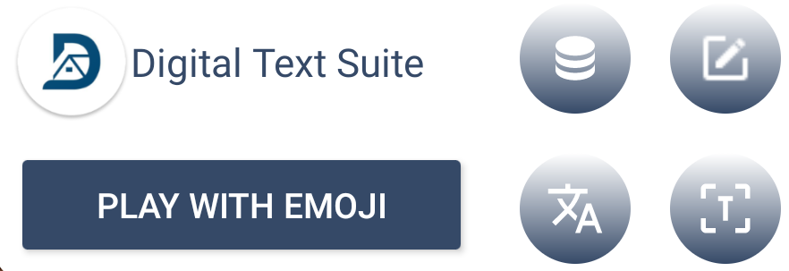
Widget

Slide 35
Widget (2)
MyAppWidget.kt
xml/my_app_widget_info.xml
Layout/layout_my_app_widget.xml

Slide 36
Widget (3): RealMainActivity
override fun onCreate(savedInstanceState: Bundle?) { super.onCreate(savedInstanceState) binding = ActivityRealMainBinding.inflate(layoutInflater) widget_metadata = intent.getIntExtra("fragment",-1) setContentView(binding.root) if(allPermissionsGranted()){ init() }else{ ActivityCompat.requestPermissions(this, REQUIRED_PERMISSIONS, REQUEST_CODE_PERMISSIONS) }

Slide 37
Widget (4): RealMainActivity
if(widget_metadata != -1) { binding.viewPagerMain.currentItem = widget_metadata }

